Slide 1
Inter-process Communications
Shyan-Ming Yuan
Email: smyuan@gmail.com
03-5712121 ext. 56631
Office hour: Monday 1:30~3:30 pm (EC442)

Slide 2
Cooperating Processes
Processes within a system may be independent or cooperating
Independent process cannot affect or be affected by the execution of another process
Cooperating processes can affect or be affected by the execution of other cooperating processes
In general, processes or threads must exchange data with each other to cooperate usefully
Cooperating processes need inter-process communication (IPC) facilities
There are two kinds of IPC models
Shared memory
Message passing

Slide 3
IPC Models

Slide 4
Purposes for IPC
Data Transfer
Sharing Data
Event notification
Resource Sharing and Synchronization
Process Control

Slide 5
IPC – Shared Memory
For processes
Each process has own private address space
Shared memory segment must be explicitly set up within each address space
For threads of the same process
There exists shared address space (use heap for shared data)
Advantages
Fast and easy to share data
Disadvantages
Must synchronize data accesses to avoid race condition

Slide 6
IPC – Message Passing
Message passing is commonly used between processes
Explicitly passing data between sender (src) and receiver (destination)
Example: pipes, sockets
Advantages:
Makes sharing explicit (readability)
Improves modularity (narrow interface)
Disadvantages:
Performance overhead to copy messages
Issues:
How to name source and destination?
One process, set of processes, or mailbox (port)
Does the sending process wait (I.e., block) for the receiver?
Blocking: Slows down the sender
Non-blocking: Requires buffering between the sender and the receiver

Slide 7
Unicast vs. Multicast

Slide 8
Message Passing in basic HTTP
Operations in server:
S1: accept connection
S2: receive request
S3: send response
S4: disconnect
Operations in browser:
C1: make connection
C2: send request
C3: receive response
C4: disconnect
Processing order: C1, S1, C2, S2, S3, C3, C4, S4

Slide 9
Synchronization in Message Passing
Message passing may be blocking or non-blocking
Blocking is considered synchronous
Blocking send: the sender blocks until the message is deliverred
Blocking receive: the receiver blocks until a message is available
Non-blocking is considered asynchronous
Non-blocking send: the sender sends the message and continues
Non-blocking receive: the receiver receives a valid message or null if no pending messages exist

Slide 10
Message Passing – case 1 Non Blocking Send and Blocking Receive
For the sender: it is natural not to be blocked
It may need to send messages to multiple destinations
A sender usually expects an acknowledgment
To know whether a receiver receives the message or not
For the receiver: it is natural to wait for desired data
A receiver usually needs the information before it can proceed
A server process that provides services to other processes
It will need the expected request to generate a proper response
It may be blocked indefinitely if the sender fails to send the request message

Slide 11
Async Send and Sync Receive
Sender Receiver

Slide 12
Message Passing – case 2 Blocking Send and Blocking Receive
Both sender and receiver are blocked until the message is delivered.
It may be used when the communication link is un-buffered (no message queue)
It provides tight synchronization (rendezvous)

Slide 13
Sync Send and Sync Receive
Sender Receiver

Slide 14
Event Diagram – Sync Send & Receive

Slide 15
Message Passing – case 3 Blocking Send and Non Blocking Receive
Sender blocked until the message is delivered
There are three possible scenarios
Receiver issues receive op after sender sends
Receiver issues receive op before sender sends
Without notification for arrival of data
With notification for arrival of data

Slide 16
Synch Send and Async Receive - 1
Data from P1 was arrived at P2 before
P2 issuing a non-blocking receive

Slide 17
Synch Send and Async Receive - 2
Data from P1 was arrived at P2 after
P2 issued a non-blocking receive

Slide 18
Synch Send and Async Receive - 3
Data from P1 was arrived at P2 after P2 issues a non-blocking receive
Later, P2 is notified of the arrival of data

Slide 19
Message Passing – case 4 Async Send and Async Receive
nonblocking
send issued
Does P1 need an acknowledgement from P2?

Slide 20
Naming in Message Passing
Direct channel:
The unique process identifiers are used for source and destination
It might be impossible to specify the source ahead of time (e.g., a print server)
Indirect channel (more convenient):
Messages are sent to a shared mailbox which consists of a queue of messages
Senders place messages in the mailbox, receivers pick them up

Slide 21
Direct Channel
Processes must name each other explicitly
Symmetric Addressing
send (P, message) – send to process P
receive (Q, message) – receive from Q
Asymmetric Addressing
send (P, message) – send to process P
receive (&id, message) – receive from any; system sets id to sender
Properties:
Links are established automatically between pairs
Processes must know each others in advance
Exactly one link per pair of communicating processes
Disadvantage: a process must know the name or ID of the processes it wishes to communicate with

Slide 22
Indirect Channel
Messages are sent to or received from mailboxes (or ports)
Each mailbox has a unique id
Processes can communicate only if they share a mailbox
Properties:
Links are established only if processes share a common mailbox
A link may be associated with more than 2 processes
Each pair of processes may share several communication links
Operations
create a new mailbox
send and receive messages through mailbox
send (A, message) – send a message to mailbox A
receive (A, message) – receive a message from mailbox A
destroy a mailbox

Slide 23
Message Buffering
While messages are in transit, they reside “in the link” (e.g., message queue)
There are three typical message queue implementations
Zero-capacity
There is no waiting message
The sender is blocked until a receiver issues a receive op
This enforces a “rendezvous”
Bounded capacity
At most n messages can reside in the queue
If the queue is full, then the sender must block
Unbounded capacity
The sender never blocks
Impossible in real world!

Slide 24
Message Passing IPCs
Pipe
FIFO (named pipe)
Socket

Slide 25
Pipes
A pipe is a unidirectional communication channel.
Data written to the “write end” of the pipe is read back from the “read end”
Pipes are FIFO devices, data is always read from the pipe in the same order it was written
Typically, a pipe is used to communicate between two threads in a single process or between parent and child processes
A pipe’s data capacity is limited
If a pipe is full, the writer process blocks until more capacity becomes available
If the reader tries to read from an empty pipe, it blocks until data becomes available
The pipe automatically synchronizes the two related processes

Slide 26
Creating pipes in Linux
To create a pipe, one can use the pipe system call
It returns an integer array of size 2
The call to pipe stores the reading file descriptor in position 0 and the writing file descriptor in position 1
For example, consider the following codes:
Data written to the file descriptor write_fd can be read back from read_fd
int pipe_fds[2];
int read_fd;
int write_fd;
pipe (pipe_fds);
read_fd = pipe_fds[0];
write_fd = pipe_fds[1];

Slide 27
An Example of Pipe
#include <unistd.h>
#include <fcntl.h>
#include <stdio.h>
char *message = "This is a message!!!" ;
main()
{ char buf[1024] ;
int fd[2];
pipe(fd); /*create pipe*/
if (fork() != 0) { /* I am the parent */
write(fd[1], message, strlen (message) + 1) ;
}
else { /*Child code */
read(fd[0], buf, 1024) ;
printf("Got this from Parent process!!: %s\n", buf) ;
}
}

Slide 28
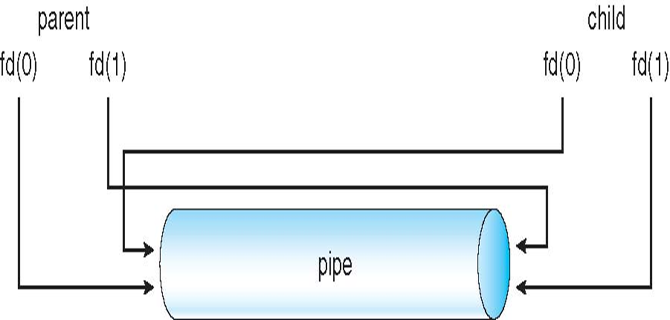
The pipe

Slide 29
FIFOs
A first-in, first-out (FIFO) file is a pipe that has a name in the file system.
Any process can open or close the FIFO.
The processes on either end of the pipe need not be related to each other.
FIFOs are also called named pipes

Slide 30
Creating FIFOs in Lunix
The mkfifo command can be used to create a FIFO
Specify the path to the FIFO on the command line
For example, create a FIFO in /tmp/fifo by invoking this:
% mkfifo /tmp/fifo
Since this named pipe looks like a file, one can use all the system calls associated with files to interact with it
In particular, one can use the open, read, write, and close system calls
The following are prototypes for each of these system calls
int open(const char *pathname, int flags);
int read(int fd, void *buf, size_t count);
int write(int fd, const void *buf, size_t count);
int close(fd);
Reading and writing to named pipes are blocking in nature
For example, if a process writes to a named pipe, it will get blocked until there is process willing to read that pipe and vice versa

Slide 31
Working with FIFO in a Shell
Creating a FIFO by the following two commands
mkfifo fifo
mknod fifo p
Reading/Writing data from/to a FIFO
open two terminals
In the first terminal, types “cat > fifo1”
In the second terminal, types “cat fifo1”
Writes to the 1st terminal
One will notice that every time an enter is typed, the corressponding line appears in the second terminal
Pressing CTRL+D in the first terminal terminates writing to fifo1
This also terminates the second process because reading from the fifo1 now generates a “BROKEN PIPE” signal
The default action for this is to terminate the process

Slide 32
Sockets
A socket is a bidirectional communication channel
It can be used to communicate with another process on the same machine or on other machine
Internet programs such as Telnet, rlogin, FTP, talk, and the World Wide Web use sockets
A socket is defined as an endpoint for communication
Named by concatenation of IP address and port number
The socket 161.25.19.8:1625 refers to
port 1625 on host 161.25.19.8.
Communication consists of a pair of sockets.

Slide 33
Socket Concepts
To create a socket, three parameters are required:
communication style, namespace, and protocol
A communication style controls how the socket treats transmitted data and specifies the number of communication partners
When data is sent through a socket, it is packaged into chunks called packets
The communication style determines how these packets are handled and how they are addressed from the sender to the receiver
Connection styles guarantee in order delivery of all packets
It is like a telephone call
The addresses of the sender and receiver are fixed at the beginning of the communication when the connection is established
Datagram styles do not guarantee delivery or arrival order
Packets may be lost or reordered in transit due to network errors or other conditions
The system guarantees only “best effort,” so packets may disappear or arrive in a different order than shipping
It behaves more like postal mail
The sender specifies the receiver’s address for each individual message

Slide 34
Socket Namespaces
A socket namespace specifies how socket addresses are written
A socket address identifies one end of a socket connection
In the “local namespace,” a socket address is an ordinary filenames
In “Internet namespace,” a socket address is composed of the Internet address (also known as an Internet Protocol address or IP address) of a host and a port number
The port number distinguishes among multiple sockets on the same host

Slide 35
Socket Protocols
A protocol specifies how data is transmitted
There are some commonly used protocols
TCP/IP, the primary networking protocols used by the Internet
the AppleTalk network protocol
the UNIX local communication protocol
Not all combinations of styles, namespaces, and protocols are supported

Slide 36
The Socket System Calls
Socket API

